Slide 1
AI/ML
Bibek Thapa

Slide 2
INTRODUCTION TO AI,ML,DL

Slide 3
AI vs ML vs DL
Artificial Intelligence (AI): Developing machines to mimic human intelligence and behaviour.
Machine Learning (ML): Algorithms that learn from structured data to predict outputs and discover patterns in that data.
Deep Learning (DL): Algorithms based on highly complex neural networks that mimic the way a human brain works to detect patterns in large unstructured data sets.

Slide 4
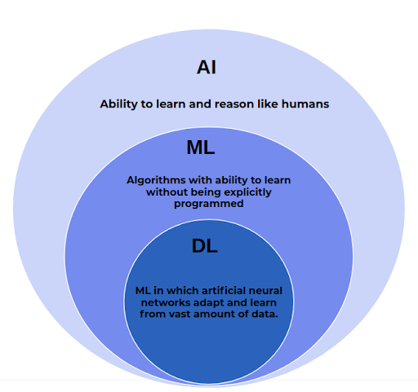

Slide 5
Machine learning
How does machine learning differ from other traditional programming ideas?
What makes machine learning so special? We will discuss it now.

Slide 6
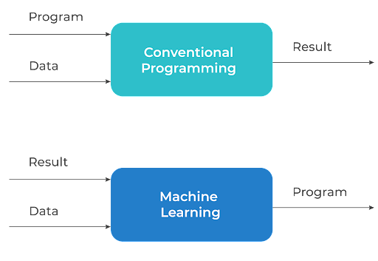

Slide 7
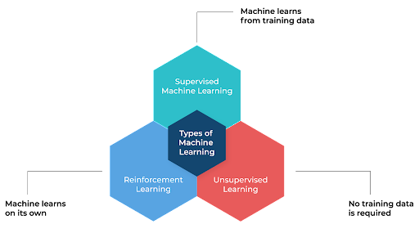
Types of Machine Learning
A very short intro for the types could be:
Supervised Learning: "Guide me through training!"
Unsupervised Learning: "I learn independently!"
Reinforcement Learning: "I make my own choices!"

Slide 8
Machine learning Lifecycle
Problem Definition
Data Collection
Data Preprocessing
Feature Engineering
Model Selection and Training
Model Evaluation and Fine Tuning
Model Deployment
Monitoring and Maintenance

Slide 9
Python and Data Structures
Demo

Slide 10
Data For Training
Training Data
Validation Data
Test Data

Slide 11
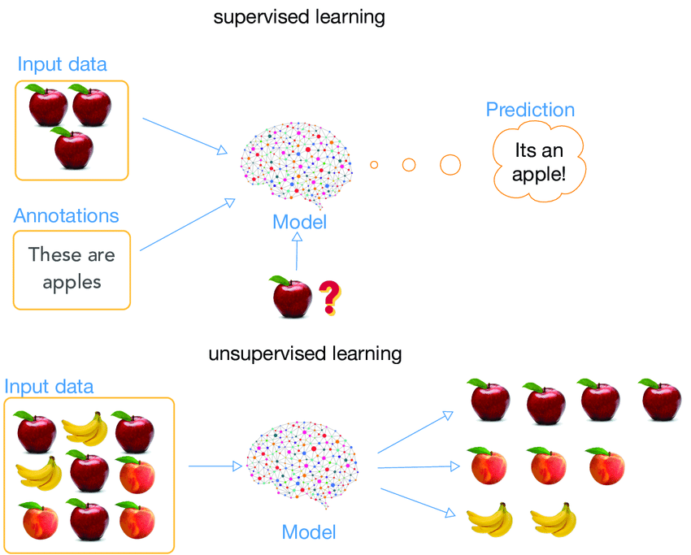
Supervised Learning and Unsupervised Learning

Slide 12
Training Data
Training data is the data we use to train a machine learning algorithm.
Training data in supervised learning consists of generally input data and their correct labels.
Training data in unsupervised learning consists of no labels and machine learning model is task to find patterns in the data.

Slide 13
Validation Data
Validation Data is a test data that our model isn’t train on but our model can predict on.
It’s unseen data during training. It helps to further tune our model.
The validation data must be labeled for supervised learning model.

Slide 14
Test Data
Validation Data is a test data that our model isn’t train on but our model can predict on.
It’s unseen data after training. It helps to evaluate our model.
The test data can be labeled or not labeled for supervised learning model.

Slide 15
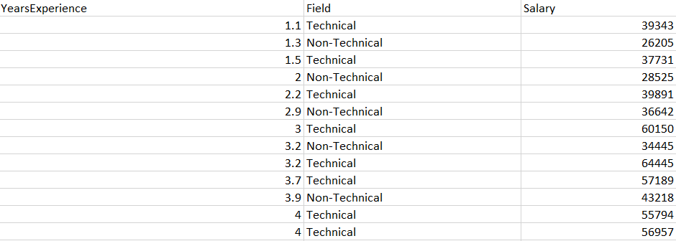
Regression Model
Works on continuous data
Given a value of X determines the Value of Y where Y is dependent on X
Example: House price prediction, sales prediction

Slide 16
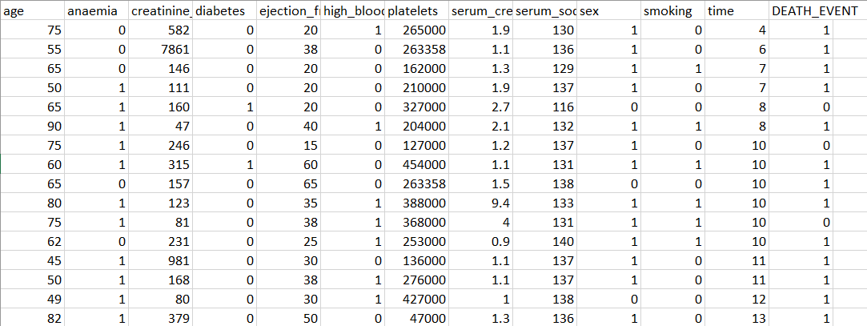
Classification Model (Numeric)
Task of identifying the label or class of the data
Works on the discrete data
Example 0 or 1 . Here 1 means Death and 0 means Alive

Slide 17
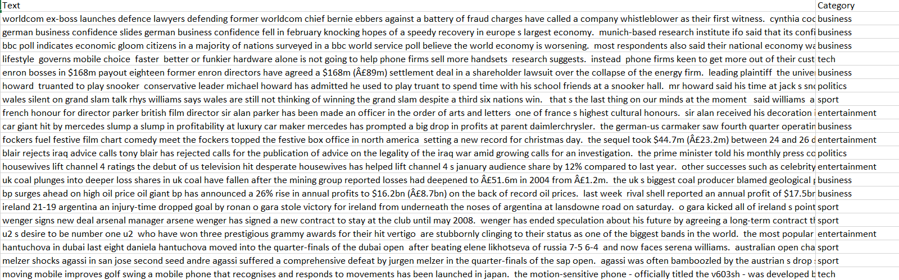
Classification Model (Text)
The input data are text and labels are also text.
But while training on the data, the data must be encoded (converted to numeric data.)

Slide 18
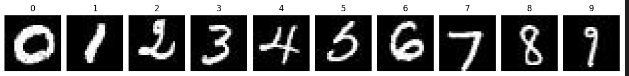
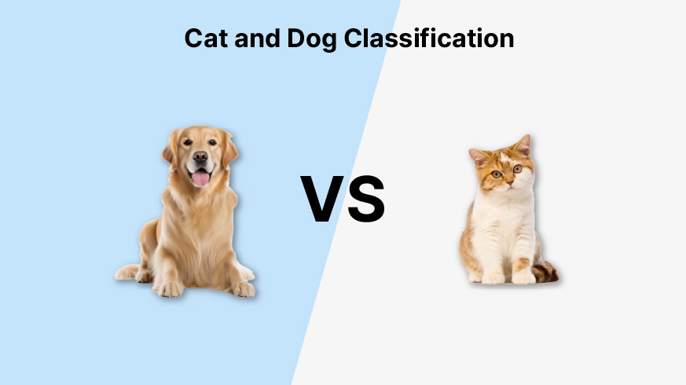
Classification Model (Image)
The input data are image and labels are text.
But while training on the data, the data must be encoded (converted to numeric data.)

Slide 19
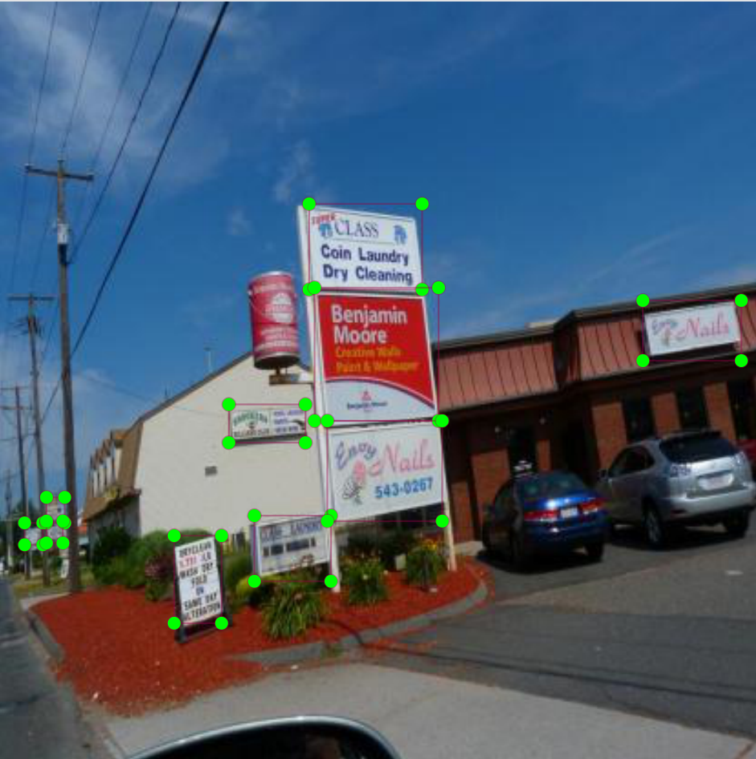
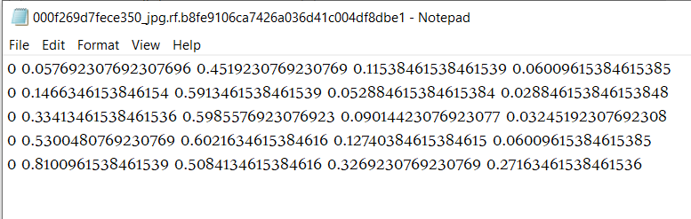
Object Detection
It will be a combination of classification and regression.
The bounding box is a regression problem and the area inside the bounding box is a classification problem.

Slide 20
Data Quality
I tried to explain the concept of 'clean data' to my LLM. It responded with, 'I prefer my data like my room: messy and full of surprises.
-ChatGPT

Slide 21
Data Quality
Satisfy the requirements of its intended use

Slide 22
Why Data Quality matters in Data Science, AI and ML
Foundation for Model Training
Ensures Model Performance
Reduces Bias and Variance
Enables Trust and Interpretability
Supports Data-driven Insights
Ensures Ethical and Responsible AI

Slide 23
Key Aspects of Data Quality
Accuracy: Ensuring the data is correct and free from errors.
Completeness: All required data is present.
Consistency: Data is consistent across different datasets and sources.
Timeliness: Data is up-to-date and available when needed.
Believability: Data is credible and trustworthy.
Interpretability: Data is easily understood and usable.

